Slide 1
Data and Computer Communications
Chapter 11 – Asynchronous Transfer Mode
Eighth Edition
by William Stallings
Lecture slides by Lawrie Brown
Notes:
Lecture slides prepared by Dr Lawrie Brown (UNSW@ADFA) for “Data and Computer Communications”, 8/e, by William Stallings, Chapter 11 “Asynchronous Transfer Mode”.

Slide 2
Asynchronous Transfer Mode
One man had a vision of railways that would link all the mainline railroad termini. His name was Charles Pearson and, though born the son of an upholsterer, he became Solicitor to the city of London. There had previously been a plan for gaslit subway streets through which horse-drawn traffic could pass. This was rejected on the grounds that such sinister tunnels would become lurking places for thieves. Twenty years before his system was built, Pearson envisaged a line running through "a spacious archway," well-lit and well-ventilated.
His was a scheme for trains in a drain.
—King Solomon's Carpet, Barbara Vine (Ruth Rendell)
Notes:
This quote is from the start of Stallings DCC8e 11, hints at the concept of a universal transport mechanism that ATM attempted to fill in data communications.

Slide 3

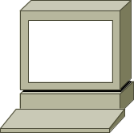

WAN Packet Switching Tech.
X.25
X.25
X.25
U-plane
LAPB
LAPB
LAPB
LAPB
LAPB
LAPB
X.21
X.21
X.21
X.21
X.21
X.21
FR
LAPF
LAPF
LAPF
LAPF
LAPF
LAPF
U-plane
C-plane
PHY
PHY
PHY
PHY
PHY
PHY
ATM
AAL
AAL
U-plane
C-plane
M-plane
ATM
ATM
ATM
ATM
ATM
ATM
PHY
PHY
PHY
PHY
PHY
PHY

Slide 4
ATM
a streamlined packet transfer interface
similarities to packet switching
  transfers data in discrete chunks
  supports multiple logical connections over a single physical interface
ATM uses fixed sized packets called cells
with minimal error and flow control
data rates of 25.6Mbps to 622.08Mbps
Notes:
ATM, also known as cell relay, is a streamlined packet transfer interface which takes advantage of the reliability and fidelity of modern digital facilities to provide faster packet switching than X.2.
Like packet switching and frame relay, ATM involves the transfer of data in discrete chunks, and allows multiple logical connections to be multiplexed over a single physical interface. In the case of ATM, the information flow on each logical connection is organized into fixed-size packets, called cells.
ATM is a streamlined protocol with minimal error and flow control capabilities. This reduces the overhead of processing ATM cells and reduces the number of overhead bits required with each cell, thus enabling ATM to operate at high data rates. Further, the use of fixed-size cells simplifies the processing required at each ATM node, again supporting the use of ATM at high data rates.

Slide 5
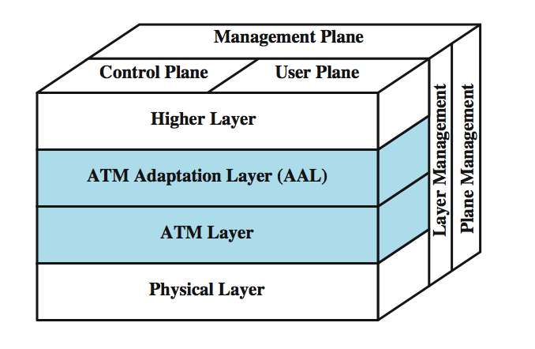
Protocol Architecture
Notes:
The standards issued for ATM by ITU-T are based on the protocol architecture shown in Stallings DCC8e Figure 11.1, which illustrates the basic architecture for an interface between user and network. The physical layer involves the specification of a transmission medium and a signal encoding scheme. The data rates specified at the physical layer range from 25.6 Mbps to 622.08 Mbps. Other data rates, both higher and lower, are possible.
Two layers of the protocol architecture relate to ATM functions. There is an ATM layer common to all services that provides packet transfer capabilities, and an ATM adaptation layer (AAL) that is service dependent. The ATM layer defines the transmission of data in fixed-size cells and defines the use of logical connections. The use of ATM creates the need for an adaptation layer to support information transfer protocols not based on ATM. The AAL maps higher-layer information into ATM cells to be transported over an ATM network, then collects information from ATM cells for delivery to higher layers.

Slide 6
Reference Model Planes
user plane
  provides for user information transfer
control plane
  call and connection control
management plane
  plane management
    whole system functions
  layer management
    Resources and parameters in protocol entities
Notes:
The protocol reference model involves three separate planes:
• User plane: Provides for user information transfer, along with associated controls (e.g., flow control, error control)
• Control plane: Performs call control and connection control functions
• Management plane: Includes plane management, which performs management functions related to a system as a whole and provides coordination between all the planes, and layer management, which performs management functions relating to resources and parameters residing in its protocol entities

Slide 7
ATM Logical Connections
virtual channel connections (VCC)
  analogous to virtual circuit in X.25
basic unit of switching between two end users
  full duplex
  fixed size cells
also for
  user-network exchange (control)
  network-network exchange (network mgmt & routing)
Notes:
Logical connections in ATM are referred to as virtual channel connections (VCCs). A VCC is analogous to a virtual circuit in X.25; it is the basic unit of switching in an ATM network. A VCC is set up between two end users through the network and a variable-rate, full-duplex flow of fixed-size cells is exchanged over the connection. VCCs are also used for user-network exchange (control signaling) and network-network exchange (network management and routing).

Slide 8
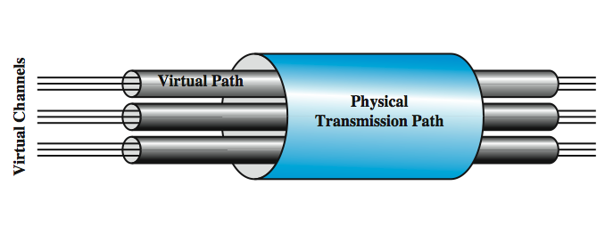
ATM Virtual Path Connection
virtual path connection (VPC)
  bundle of VCC with same end points
Notes:
For ATM, a second sublayer of processing has been introduced that deals with the concept of virtual path (Figure 11.2). A virtual path connection (VPC) is a bundle of VCCs that have the same endpoints. Thus, all of the cells flowing over all of the VCCs in a single VPC are switched together. The virtual path concept was developed in response to a trend in high-speed networking in which the control cost of the network is becoming an increasingly higher proportion of the overall network cost. The virtual path technique helps contain the control cost by grouping connections sharing common paths through the network into a single unit. Network management actions can then be applied to a small number of groups of connections instead of a large number of individual connections.
The terminology of virtual paths and virtual channels used in the standard is a bit confusing and is summarized in Stallings DCC8e Table 11.1. Whereas most of the network-layer protocols that we deal with in this book relate only to the user-network interface, the concepts of virtual path and virtual channel are defined in the ITU-T Recommendations with reference to both the user-network interface and the internal network operation.

Slide 9
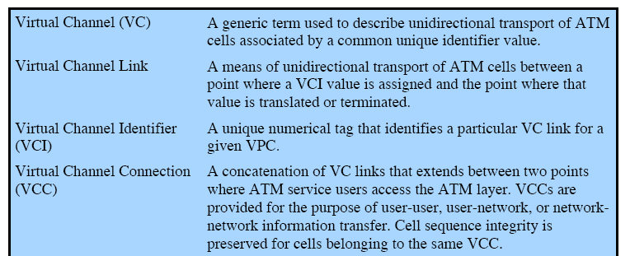
Virtual Channel Terminology

Slide 10
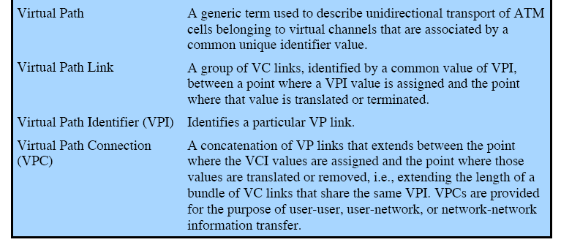
Virtual Path Terminology
VPI

Slide 11
VP/VC Switching -1
VPI 1
VPI 3
VCI 1
VCI 1
VCI 2
VCI 2
VCI 3
VCI 3
VPI 2
VPI 4
VCI 1
VCI 1
VCI 2
VCI 2
VCI 3
VCI 3
VPI 3
VPI 1
VCI 3
VCI 4
VCI 1
VPI 4
VCI 2
VCI 3
VCI 1
VCI 4
VCI 2
VCI 3
VPI 2
VPI 5
VCI 1
VCI 2
VCI 1
VCI 3
VCI 2

Slide 12
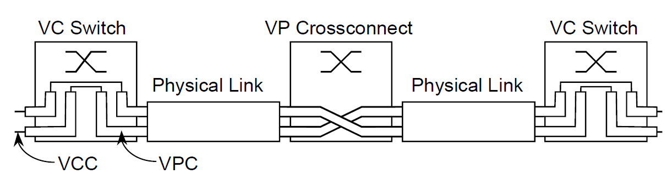
VP/VC Switching -2

Slide 13
Advantages of Virtual Paths
simplified network architecture
increased network performance and reliability
reduced processing
short connection setup time
enhanced network services
Notes:
Several advantages can be listed for the use of virtual paths:
• Simplified network architecture: Network transport functions can be separated into those related to an individual logical connection (virtual channel) and those related to a group of logical connections (virtual path).
• Increased network performance and reliability: The network deals with fewer, aggregated entities.
• Reduced processing and short connection setup time: Much of the work is done when the virtual path is set up. By reserving capacity on a virtual path connection in anticipation of later call arrivals, new virtual channel connections can be established by executing simple control functions at the endpoints of the virtual path connection; no call processing is required at transit nodes. Thus, the addition of new virtual channels to an existing virtual path involves minimal processing.
• Enhanced network services: The virtual path is used internal to the network but is also visible to the end user. Thus, the user may define closed user groups or closed networks of virtual channel bundles.

Slide 14
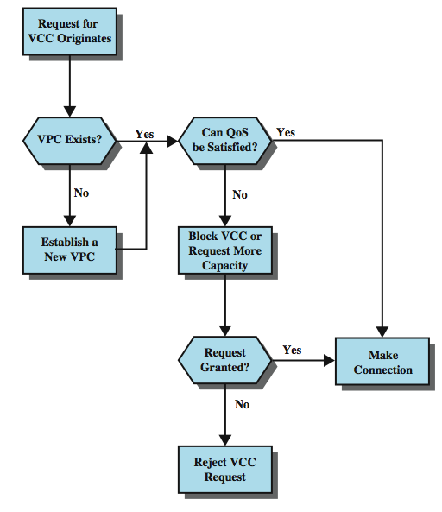
Call
Establishment
Using VPs
Notes:
Stallings DCC8e Figure 11.3 suggests in a general way the call establishment process using virtual channels and virtual paths. The process of setting up a virtual path connection is decoupled from the process of setting up an individual virtual channel connection:
• The virtual path control mechanisms include calculating routes, allocating capacity, and storing connection state information.
• To set up a virtual channel, there must first be a virtual path connection to the required destination node with sufficient available capacity to support the virtual channel, with the appropriate quality of service. A virtual channel is set up by storing the required state information (virtual channel/virtual path mapping).

Slide 15
Virtual Channel Connection Uses
between end users
  end to end user data
  control signals
  VPC provides overall capacity
    VCC organization done by users
between end user and network
  control signaling
between network entities
  network traffic management
  routing for the exchange of network management information
Notes:
The endpoints of a VCC may be end users, network entities, or an end user and a network entity. In all cases, cell sequence integrity is preserved within a VCC: that is, cells are delivered in the same order in which they are sent. Let us consider examples of the three uses of a VCC:
• Between end users: Can be used to carry end-to-end user data; can also be used to carry control signaling between end users, as explained later. A VPC between end users provides them with an overall capacity; the VCC organization of the VPC is up to the two end users, provided the set of VCCs does not exceed the VPC capacity.
• Between an end user and a network entity: Used for user-to-network control signaling, as discussed subsequently. A user-to-network VPC can be used to aggregate traffic from an end user to a network exchange or network server.
• Between two network entities: Used for network traffic management and routing functions. A network-to-network VPC can be used to define a common route for the exchange of network management information.

Slide 16
VP/VC Characteristics
quality of service: cell loss ratio, cell delay variation
switched and semi-permanent channel connections
call sequence integrity
traffic parameter negotiation and usage monitoring
VPC only
  virtual channel identifier restriction within VPC
Notes:
ITU-T Recommendation I.150 lists the following as characteristics of virtual channel connections:
• Quality of service (QoS): A user of a VCC is provided with a QoS specified by parameters such as cell loss ratio and cell delay variation.
• Switched and semipermanent virtual channel connections: A switched VCC is an on-demand connection, which requires a call control signaling for setup and tearing down. A semipermanent VCC is one that is of long duration and is set up by configuration or network management action.
• Cell sequence integrity: sequence of cells sent within a VCC is preserved.
• Traffic parameter negotiation and usage monitoring: Traffic parameters can be negotiated between a user and the network for each VCC, including average rate, peak rate, burstiness, and peak duration. The network monitors the input of cells to the VCC, ensuring negotiated parameters are not violated.
I.150 also lists characteristics of VPCs. The first four characteristics listed are identical to those for VCCs. The fifth characteristic listed for VPCs is:
Virtual channel identifier restriction within a VPC: One or more virtual channel identifiers, or numbers, may not be available to the user of the VPC but may be reserved for network use. Examples include VCCs used for network management.

Slide 17
Control Signaling - VCC
to establish or release VCCs & VPCs
uses a separate connection
methods are:
  semi-permanent VCC
  meta-signaling channel
  user to network signaling virtual channel
  user to user signaling virtual channel
Notes:
In ATM, a mechanism is needed for the establishment and release of VPCs and VCCs. The exchange of information involved in this process is referred to as control signaling and takes place on separate connections from those that are being managed. For VCCs, I.150 specifies four methods for providing an establishment/release facility. One or a combination of these methods will be used in any particular network:
1. Semipermanent VCCs may be used for user-to-user exchange. In this case, no control signaling is required.
2. If there is no preestablished call control signaling channel, then one must be set up. For that purpose, a control signaling exchange must take place between the user and the network on some channel. Hence we need a permanent channel, probably of low data rate, that can be used to set up VCCs that can be used for call control. Such a channel is called a meta-signaling channel, as the channel is used to set up signaling channels.
3. The meta-signaling channel can be used to set up a VCC between the user and the network for call control signaling. This user-to-network signaling virtual channel can then be used to set up VCCs to carry user data.
4. The meta-signaling channel can also be used to set up a user-to-user signaling virtual channel. Such a channel must be set up within a preestablished VPC. It can be used to allow the two end users, without network intervention, to establish and release user-to-user VCCs to carry user data.

Slide 18
Control Signaling - VPC
methods for control signalling for VPCs:
  Semi-permanent
  Customer controlled
  Network controlled
Notes:
For VPCs, three methods are defined in I.150:
1. A VPC can be established on a semipermanent basis by prior agreement. In this case, no control signaling is required.
VPC establishment/release may be customer controlled. In this case, the customer uses a signaling VCC to request the VPC from the network.
3. VPC establishment/release may be network controlled. In this case, the network establishes a VPC for its own convenience. The path may be network-to-network, user-to-network, or user-to-user.

Slide 19
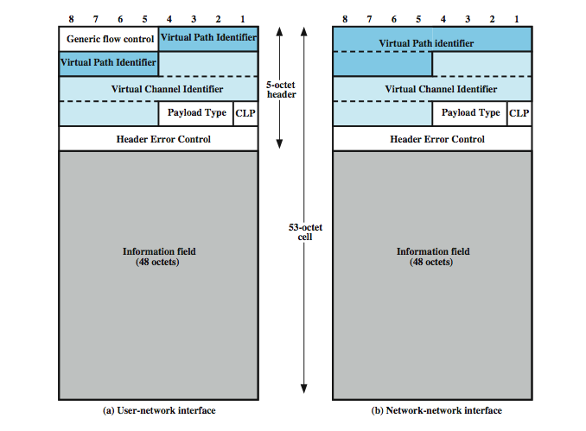
ATM Cells
Notes:
The asynchronous transfer mode makes use of fixed-size cells, consisting of a 5-octet header and a 48-octet information field. There are several advantages to the use of small, fixed-size cells. First, the use of small cells may reduce queuing delay for a high-priority cell, because it waits less if it arrives slightly behind a lower-priority cell that has gained access to a resource (e.g., the transmitter). Second, it appears that fixed-size cells can be switched more efficiently, which is important for the very high data rates of ATM. With fixed-size cells, it is easier to implement the switching mechanism in hardware.
Stallings DCC8e Figure 11.4a shows the cell header format at the user-network interface, & Figure 11.4b shows the cell header format internal to the network.

Slide 20
ATM Header Fields
generic flow control
Virtual path identifier
Virtual channel identifier
payload type
cell loss priority
header error control
Notes:
The Generic Flow Control (GFC) field does not appear in the cell header internal to the network, but only at the user-network interface, and is used for control of cell flow only at the local user-network interface, to alleviate short-term overload conditions in the network.
The Virtual Path Identifier (VPI) constitutes a routing field for the network. It is 8 bits at the user-network interface and 12 bits at the network-network interface. The Virtual Channel Identifier (VCI) is used for routing to and from the end user.
The Payload Type (PT) field indicates the type of information in the information field. A value of 0 in the first bit indicates user information. In this case, the second bit indicates whether congestion has been experienced; the third bit, known as the Service Data Unit (SDU) type bit, is a one-bit field that can be used to discriminate two types of ATM SDUs associated with a connection. Thus, the PT field can provide inband control information.
The cell loss priority (CLP) bit is used to provide guidance to the network in the event of congestion. A value of 0 indicates a cell of relatively higher priority, which should not be discarded unless no other alternative is available. A value of 1 indicates that this cell is subject to discard within the network.
The Header Error Control (HEC) field is used for both error control and synchronization, as explained subsequently.

Slide 21
Generic Flow Control (GFC)
control traffic flow at user to network interface (UNI) to alleviate short term overload
two sets of procedures
  uncontrolled transmission
  controlled transmission
every connection subject to flow control or not
if subject to flow control
  may be one group (A) default
  may be two groups (A and B)
flow control is from subscriber to network
Notes:
I.150 specifies the use of the GFC field to control traffic flow at the user-network interface (UNI) in order to alleviate short-term overload conditions. The actual flow control mechanism is defined in I.361. CCT is intended to provide good service for high-volume bursty traffic with variable-length messages. When the equipment at the UNI is configured to support the GFC mechanism, two sets of procedures are used: uncontrolled transmission and controlled transmission. In essence, every connection is identified as either subject to flow control or not. Of those subject to flow control, there may be one group of controlled connections (Group A) that is the default, or controlled traffic may be classified into two groups of controlled connections (Group A and Group B); these are known, respectively, as the one-queue and two-queue models. Flow control is exercised in the direction from the subscriber to the network by the network side.

Slide 22
GFC - Single Group of Connections
If TRANSMIT=1 send uncontrolled cells any time. If TRANSMIT=0 no cells may be sent
If HALT received, TRANSMIT=0 until NO_HALT
If TRANSMIT=1 & no uncontrolled cell to send:
  If GO_CNTR>0, TE may send controlled cell and decrement GO_CNTR
  If GO_CNTR=0, TE may not send controlled cells
TE sets GO_CNTR to GO_VALUE upon receiving SET signal
Notes:
First consider the operation of the GFC mechanism when there is only one group of controlled connections. The controlled equipment (terminal equipment - TE), initializes two variables: TRANSMIT is a flag initialized to SET (1), and GO_CNTR, which is a credit counter, is initialized to 0. A third variable, GO_VALUE, is either initialized to 1 or set to some larger value at configuration time. The rules for transmission are as follows:
1. If TRANSMIT = 1, cells on uncontrolled connections may be sent at any time. If TRANSMIT = 0, no cells may be sent on either controlled or uncontrolled connections.
2. If a HALT signal is received from the controlling equipment, TRANSMIT is set to 0 and remains at zero until a NO_HALT signal is received, at which time TRANSMIT is set to 1.
3. If TRANSMIT = 1 and there is no cell to transmit on any uncontrolled connections, then
—If GO_CNTR > 0, then the TE may send a cell on a controlled connection. The TE marks that cell as a cell on a controlled connection and decrements GO_CNTR.
—If GO_CNTR = 0, then the TE may not send a cell on a controlled connection.
4. The TE sets GO_CNTR to GO_VALUE upon receiving a SET signal; a null signal has no effect on GO_CNTR.

Slide 23
Use of HALT
to limit effective data rate on ATM
should be cyclic
to reduce data rate by half, HALT issued to be in effect 50% of time
done on regular pattern over lifetime of connection
Notes:
The HALT signal is used logically to limit the effective ATM data rate and should be cyclic. For example, to reduce the data rate over a link by half, the HALT command is issued by the controlling equipment so as to be in effect 50% of the time. This is done in a predictable, regular pattern over the lifetime of the physical connection.

Slide 24
Two Queue Model
uses two counters each with current & initial values:
  GO_CNTR_A
  GO_VALUE_A
  GO_CNTR_B
  GO_VALUE_B
Notes:
For the two-queue model, there are two counters, each with a current counter value and an initialization value: GO_CNTR_A, GO_VALUE_A, GO_CNTR_B, and GO_VALUE_B. This enables the network to control two separate groups of connections.

Slide 25
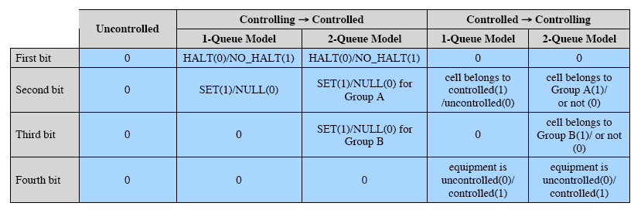
GFC Field Coding
Two directions
Flow control is exercised in the direction from the subscriber to the network by the network side

Slide 26
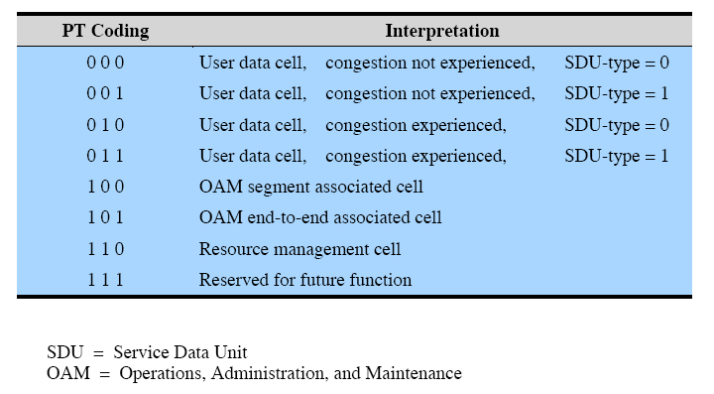
Payload Type (PT) Coding

Slide 27
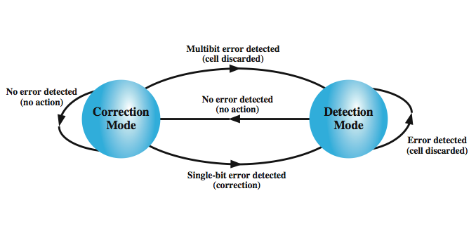
Header Error Control
Notes:
Each ATM cell includes an 8-bit HEC field that is calculated based on the remaining 32 bits of the header. The polynomial used to generate the code is X⁸ + X² + X + 1. In most existing protocols that include an error control field, such as HDLC, the data that serve as input to the error code calculation are in general much longer than the size of the resulting error code. This allows for error detection. In the case of ATM, the input to the calculation is only 32 bits, compared to 8 bits for the code. The fact that the input is relatively short allows the code to be used not only for error detection but also, in some cases, for actual error correction. This is because there is sufficient redundancy in the code to recover from certain error patterns.
Stallings DCC8e Figure 11.5 depicts the operation of the HEC algorithm at the receiver. At initialization, the receiver's error correction algorithm is in the default mode for single-bit error correction. As each cell is received, the HEC calculation and comparison is performed. As long as no errors are detected, the receiver remains in error correction mode. When an error is detected, the receiver will correct the error if it is a single-bit error or will detect that a multibit error has occurred. In either case, the receiver now moves to detection mode.

Slide 28
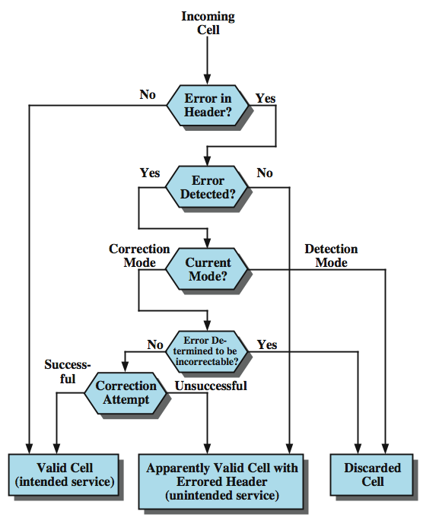
Effect of
Error in
Cell Header
Notes:
In correction mode, no attempt is made to correct errors. The reason for this change is a recognition that a noise burst or other event might cause a sequence of errors, a condition for which the HEC is insufficient for error correction. The receiver remains in detection mode as long as errored cells are received. When a header is examined and found not to be in error, the receiver switches back to correction mode. The flowchart of Stallings DCC8e Figure 11.6 shows the consequence of errors in the cell header.

Slide 29
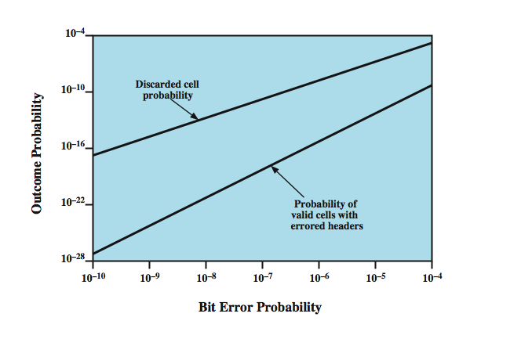
Impact of Random Bit Errors on HEC Performance
Notes:
The error-protection function provides both recovery from single-bit header errors and a low probability of the delivery of cells with errored headers under bursty error conditions. The error characteristics of fiber-based transmission systems appear to be a mix of single-bit errors and relatively large burst errors. For some transmission systems, the error correction capability, which is more time-consuming, might not be invoked. Stallings DCC8e Figure 11.7, based on one in ITU-T I.432, indicates how random bit errors impact the probability of occurrence of discarded cells and valid cells with errored headers when HEC is employed.

Slide 30
Transmission of ATM Cells
I.432 specifies several data rates:
  622.08Mbps
  155.52Mbps
  51.84Mbps
  25.6Mbps
two choices of transmission structure:
  Cell based physical layer
  SDH based physical layer
Notes:
I.432 specifies that ATM cells may be transmitted at one of several data rates: 622.08 Mbps, 155.52 Mbps, 51.84 Mbps, or 25.6 Mbps. We need to specify the transmission structure that will be used to carry this payload. Two approaches are defined in I.432: a cell-based physical layer and an SDH-based physical layer. We examine each of these approaches in turn.

Slide 31
Cell Based Physical Layer
no framing imposed
continuous stream of 53 octet cells
cell delineation based on header error control field
Notes:
For the cell-based physical layer, no framing is imposed. The interface structure consists of a continuous stream of 53-octet cells. Because there is no external frame imposed in the cell-based approach, some form of synchronization is needed. Synchronization is achieved on the basis of the HEC field in the cell header.

Slide 32
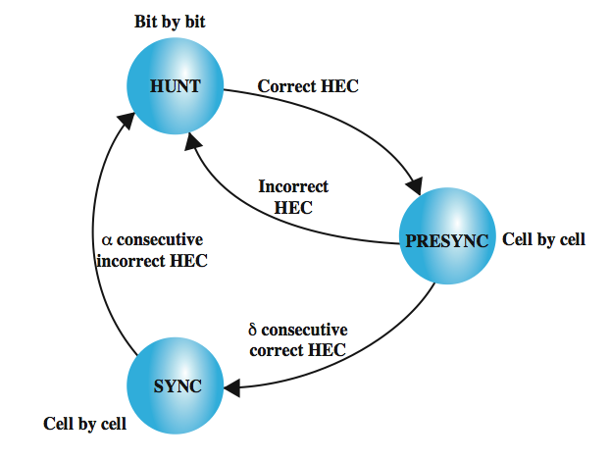
Cell Delineation State Diagram
Notes:
Figure 11.8 shows the procedure used as follows:
1. In the HUNT state, a cell delineation algorithm is performed bit by bit to determine if the HEC coding law is observed (i.e., match between received HEC and calculated HEC). Once a match is achieved, it is assumed that one header has been found, and the method enters the PRESYNC state.
2. In the PRESYNC state, a cell structure is now assumed. The cell delineation algorithm is performed cell by cell until the encoding law has been confirmed consecutively δ times.
3. In the SYNC state, the HEC is used for error detection and correction (see Figure 11.5). Cell delineation is assumed to be lost if the HEC coding law is recognized consecutively as incorrect α times.
The values of α and δ are design parameters. Greater values of δ result in longer delays in establishing synchronization but in greater robustness against false delineation. Greater values of α result in longer delays in recognizing a misalignment but in greater robustness against false misalignment.
The advantage of using a cell-based transmission scheme is the simplified interface that results when both transmission and transfer mode functions are based on a common structure.

Slide 33
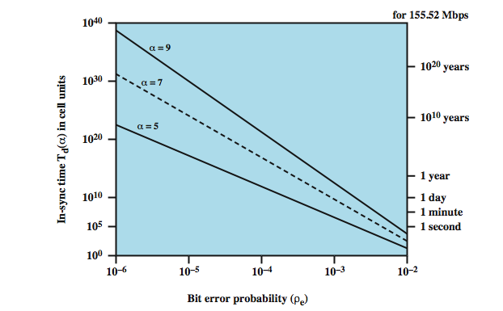
Impact of Random Bit Errors on Cell Delineation Performance
Notes:
Stallings DCC8e Figures 11.9 and 11.10, based on I.432, show the impact of random bit errors on cell delineation performance for various values of α and δ.
The first figure shows the average amount of time that the receiver will maintain synchronization in the face of errors, with α as a parameter.

Slide 34
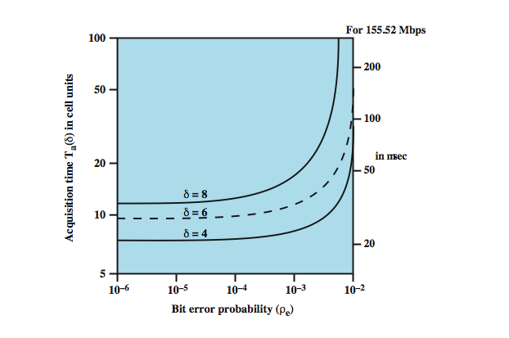
Acquisition Time v Bit Error Rate
Notes:
Stallings DCC8e Figures 11.9 and 11.10, based on I.432, show the impact of random bit errors on cell delineation performance for various values of α and δ.
The second figure shows the average amount of time to acquire synchronization as a function of error rate, with δ as a parameter.

Slide 35
SDH Based Physical Layer
imposes structure on ATM stream
  e.g. for 155.52Mbps
  use STM-1 (STS-3) frame
can carry ATM and STM payloads
specific connections can be circuit switched using SDH channel
SDH multiplexing techniques can combine several ATM streams
Notes:
The SDH-based physical layer imposes a structure on the ATM cell stream. In this section, we look at the I.432 specification for 155.52 Mbps; similar structures are used at other data rates. The advantages of the SDH-based approach include:
• It can be used to carry either ATM-based or STM-based (synchronous transfer mode) payloads, making it possible to initially deploy a high-capacity fiber-based transmission infrastructure for a variety of circuit-switched and dedicated applications and then readily migrate to the support of ATM.
• Some specific connections can be circuit switched using an SDH channel. For example, a connection carrying constant-bit-rate video traffic can be mapped into its own exclusive payload envelope of the STM-1 signal, which can be circuit switched. This may be more efficient than ATM switching.
• Using SDH synchronous multiplexing techniques, several ATM streams can be combined to build interfaces with higher bit rates than those supported by the ATM layer at a particular site. For example, four separate ATM streams, each with a bit rate of 155 Mbps (STM-1), can be combined to build a 622-Mbps (STM-4) interface. This arrangement may be more cost effective than one using a single 622-Mbps ATM stream.

Slide 36
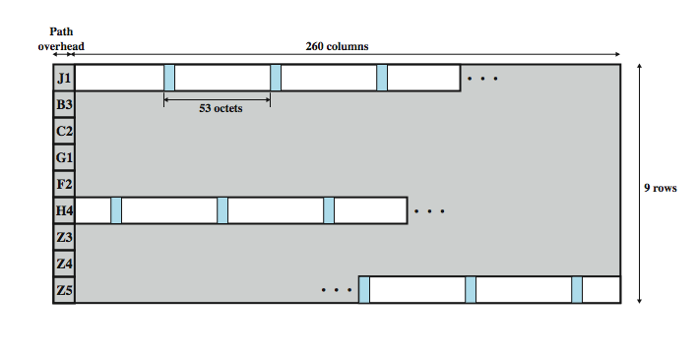
STM-1 Payload for SDH-Based ATM Cell Transmission
Notes:
For the SDH-based physical layer, framing is imposed using the STM-1 (STS-3) frame. Stallings DCC8e Figure 11.11 shows the payload portion of an STM-1 frame (for comparison, see Stallings DCC8e Figure 8.11). This payload may be offset from the beginning of the frame, as indicated by the pointer in the section overhead of the frame. As can be seen, the payload consists of a 9-octet path overhead portion and the remainder, which contains ATM cells. Because the payload capacity (2340 octets) is not an integer multiple of the cell length (53 octets), a cell may cross a payload boundary.
The H4 octet in the path overhead is set at the sending side to indicate the next occurrence of a cell boundary. That is, the value in the H4 field indicates the number of octets to the first cell boundary following the H4 octet. The permissible range of values is 0 to 52.

Slide 37
ATM Service Categories
Real time - limit amount/variation of delay
  Constant bit rate (CBR)
  Real time variable bit rate (rt-VBR)
Non-real time - for bursty traffic
  Non-real time variable bit rate (nrt-VBR)
  Available bit rate (ABR)
  Unspecified bit rate (UBR)
  Guaranteed frame rate (GFR)
Notes:
An ATM network is designed to be able to transfer many different types of traffic simultaneously, including real-time flows such as voice, video, and bursty TCP flows. Although each such traffic flow is handled as a stream of 53-octet cells traveling through a virtual channel, the way in which each data flow is handled within the network depends on the characteristics of the traffic flow and the requirements of the application. For example, real-time video traffic must be delivered within minimum variation in delay. In this section, we summarize ATM service categories, which are used by an end system to identify the type of service required. The following service categories have been defined by the ATM Forum:
Real-Time Service: The most important distinction among applications concerns the amount of delay and the variability of delay, referred to as jitter, that the application can tolerate. Real-time applications typically involve a flow of information to a user that is intended to reproduce that flow at a source. Variants include Constant bit rate (CBR) & Real-time variable bit rate (rt-VBR)
Non-Real-Time Service: are intended for applications that have bursty traffic characteristics and do not have tight constraints on delay and delay variation. Accordingly, the network has greater flexibility in handling such traffic flows and can make greater use of statistical multiplexing to increase network efficiency. Variants include: Non-real-time variable bit rate (nrt-VBR), Available bit rate (ABR), Unspecified bit rate (UBR), & Guaranteed frame rate (GFR)

Slide 38
Constant Bit Rate (CBR)
fixed data rate continuously available
tight upper bound on delay
uncompressed audio and video
  video conferencing
  interactive audio
  A/V distribution and retrieval
Notes:
Real-time applications typically involve a flow of information to a user that is intended to reproduce that flow at a source. For example, a user expects a flow of audio or video information to be presented in a continuous, smooth fashion. A lack of continuity or excessive loss results in significant loss of quality. Applications that involve interaction between people have tight constraints on delay. Typically, any delay above a few hundred milliseconds becomes noticeable and annoying.
The CBR service is perhaps the simplest real-time service to define. It is used by applications that require a fixed data rate that is continuously available during the connection lifetime and a relatively tight upper bound on transfer delay. CBR is commonly used for uncompressed audio and video information. Example of CBR applications include:
• Videoconferencing
• Interactive audio (e.g., telephony)
• Audio/video distribution (e.g., television, distance learning, pay-per-view)
Audio/video retrieval (e.g., video-on-demand, audio library)

Slide 39
Real-Time Variable Bit Rate
(rt-VBR)
for time sensitive applications
  tightly constrained delay and delay variation
rt-VBR applications transmit data at a rate that varies with time
  e.g. compressed video
  produces varying sized image frames
  original (uncompressed) frame rate constant
  so compressed data rate varies
hence can statistically multiplex connections
Notes:
The rt-VBR category is intended for time-sensitive applications; that is, those requiring tightly constrained delay and delay variation. The principal difference between applications appropriate for rt-VBR and those appropriate for CBR is that rt-VBR applications transmit at a rate that varies with time. Equivalently, an rt-VBR source can be characterized as somewhat bursty. For example, the standard approach to video compression results in a sequence of image frames of varying sizes. Because real-time video requires a uniform frame transmission rate, the actual data rate varies.
The rt-VBR service allows the network more flexibility than CBR. The network is able to statistically multiplex a number of connections over the same dedicated capacity and still provide the required service to each connection.

Slide 40
Non-Real-Time Variable Bit Rate (nrt-VBR)
if can characterize expected bursty traffic flow
  e.g. airline reservations, banking transactions
ATM net allocates resources based on this
  to meet critical response-time requirements
giving improved QoS in loss and delay
end system specifies:
  peak cell rate
  sustainable or average rate
  measure of how bursty traffic is
Notes:
Non-real-time services are intended for applications that have bursty traffic characteristics and do not have tight constraints on delay and delay variation. Accordingly, the network has greater flexibility in handling such traffic flows and can make greater use of statistical multiplexing to increase network efficiency.
For some non-real-time applications, it is possible to characterize the expected traffic flow so that the network can provide substantially improved QoS in the areas of loss and delay. Such applications can use the nrt-VBR service. With this service, the end system specifies a peak cell rate, a sustainable or average cell rate, and a measure of how bursty or clumped the cells may be. With this information, the network can allocate resources to provide relatively low delay and minimal cell loss. The nrt-VBR service can be used for data transfers that have critical response-time requirements. Examples include airline reservations, banking transactions, and process monitoring.

Slide 41
Available Bit Rate (ABR)
application specifies peak cell rate (PCR) and minimum cell rate (MCR)
resources allocated to give at least MCR
spare capacity shared among all ABR sources
  e.g. LAN interconnection
Notes:
Bursty applications that use a reliable end-to-end protocol such as TCP can detect congestion in a network by means of increased round-trip delays and packet discarding. This is discussed in Stallings DCC8e Chapter 20. However, TCP has no mechanism for causing the resources within the network to be shared fairly among many TCP connections. Further, TCP does not minimize congestion as efficiently as is possible using explicit information from congested nodes within the network. To improve the service provided to bursty sources that would otherwise use UBR, the ABR service has been defined. An application using ABR specifies a peak cell rate (PCR) that it will use and a minimum cell rate (MCR) that it requires. The network allocates resources so that all ABR applications receive at least their MCR capacity. Any unused capacity is then shared in a fair and controlled fashion among all ABR sources. The ABR mechanism uses explicit feedback to sources to assure that capacity is fairly allocated. Any capacity not used by ABR sources remains available for UBR traffic. An example of an application using ABR is LAN interconnection. In this case, the end systems attached to the ATM network are routers.

Slide 42
Unspecified Bit Rate (UBR)
may be additional capacity over and above that used by CBR and VBR traffic
  not all resources dedicated to CBR/VBR traffic
  unused cells due to bursty nature of VBR
for application that can tolerate some cell loss or variable delays
  e.g. TCP based traffic
cells forwarded on FIFO basis
best effort service
Notes:
At any given time, a certain amount of the capacity of an ATM network is consumed in carrying CBR and the two types of VBR traffic. Additional capacity is available for one or both of the following reasons: (1) Not all of the total resources have been committed to CBR and VBR traffic, and (2) the bursty nature of VBR traffic means that at some times less than the committed capacity is being used. All of this unused capacity could be made available for the UBR service. This service is suitable for applications that can tolerate variable delays and some cell losses, which is typically true of TCP-based traffic. With UBR, cells are forwarded on a first-in-first-out (FIFO) basis using the capacity not consumed by other services; both delays and variable losses are possible. No initial commitment is made to a UBR source and no feedback concerning congestion is provided; this is referred to as a best-effort service. Examples of UBR applications include: Text/data/image transfer, messaging, distribution, retrieval; or Remote terminal (e.g., telecommuting).

Slide 43
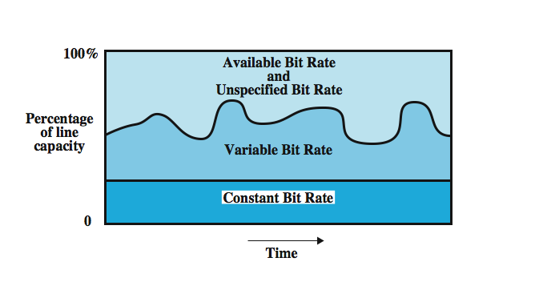
ATM Bit Rate Services
Notes:
Stallings DCC8e Figure 11.12 suggests how a network allocates resources during a steady-state period of time (no additions or deletions of virtual channels).

Slide 44
Summary of ATM
3-plane high-speed cell switching
Virtual Circuit in ATM layer
  2-layered VC: VPI + VCI
Controls left in ATM
  Generic Flow Control (User-Network Interface)
  Congestion Control
Concept of Quality-of-Service (QoS)
  QoS parameters + Traffic parameters

Slide 45
Summary of ATM Services
QoS part
Traffic part
CBR
Tight delay bound
Fixed data rate
rt-VBR
Tightly constrained delay & delay variation
Peak/Avg. cell rate, traffic burstiness
nrt-VBR
Improved QoS in loss and delay
Peak/Avg. cell rate, traffic burstiness
ABR
Spare capacity shared among all ABR sources
Peak/Min. cell rate
Tolerate some cell loss or variable delays, BE
UBR
Unspecified

Slide 46
Summary
Asynchronous Transfer Mode (ATM)
architecture & logical connections
ATM Cell format
transmission of ATM cells
ATM services
Notes:
Chapter11 summary.

